Slide 1
Plymouth City Youth Council
The Plymouth Mayflower 400
Citizenship Project: Session 1: Rules, a dilemma
Your city; your school; your future; your

Slide 2
Plymouth City Youth Council
The year is 2020 and Mayflower II has embarked upon a journey to the new world of Separatia to create a new colony. On board are a team of scientists and a larger group of skilled workers and their families
Notes:
Use the scenario, below, or a similar one of your choice, to introduce the idea of the creation of a rule system and the mechanisms needed to put rules in place and to enable them to be kept…or not.
This is a discussion/dramatised piece that may also need post-it notes, paper and pens to collect ideas.
The class should split into two groups and identify as workers and their families or the scientists, who do not have family members with them.
Key word to explore prior to the lesson: colony – this should have been a key word in the Mayflower story, itself that this work set assumes the children have already engaged with.

Slide 3
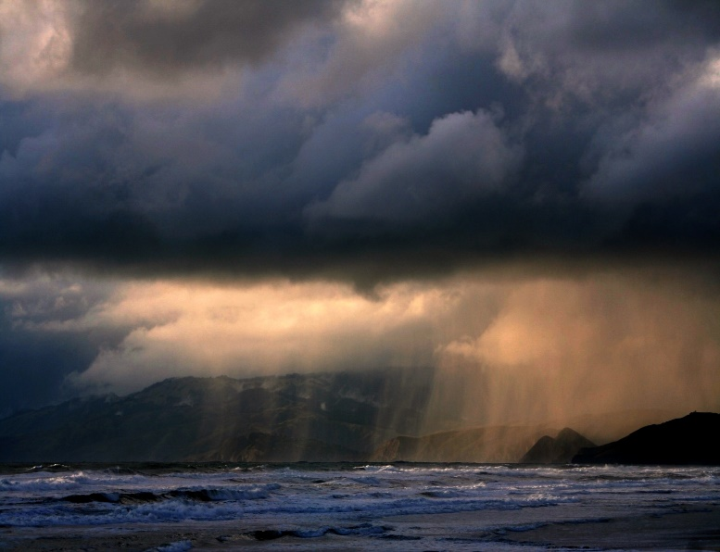
Plymouth City Youth Council
The aim of this voyage is to create a new colony and expand the territory of their home nation. Unfortunately, due to a storm, the Mayflower II is shipwrecked in an area unknown to the colonists. They are lost in a desolate land.
Notes:
Use the scenario in the PowerPoint, or a similar one of your choice, to introduce the idea of the creation of a rule system and the mechanisms needed to put rules in place and to enable them to be kept…or not. This is a discussion/dramatised piece that may also need post-it notes, paper and pens to collect ideas.
The class should split into two groups and identify as workers and their families or the scientists, who do not have family members with them.
Key word to explore prior to the lesson: colony – this should have been a key word in the Mayflower story, itself that this work set assumes the children have already engaged with.

Slide 4
Plymouth City Youth Council
Although the shipwreck has destroyed the ship and its communication devices, all passengers remain well, with nothing more than a few cuts and bruises. The scientists and workers will be able to build structures to live in. They hope for a rescue, but no-one knows they are missing and they have no means of communicating with the outside world.
Notes:
Use the scenario in the powerpoint or a similar one of your choice, to introduce the idea of the creation of a rule system and the mechanisms needed to put rules in place and to enable them to be kept…or not. This is a discussion/dramatised piece that may also need post-it notes, paper and pens to collect ideas.
The class should split into two groups and identify as workers and their families or the scientists, who do not have family members with them.
Key word to explore prior to the lesson: colony – this should have been a key word in the Mayflower story, itself that this work set assumes the children have already engaged with.

Slide 5
Plymouth City Youth Council
An argument breaks out between the scientists and workers. The workers feel that the need for survival is most important. Some of them have children. They know how to build shelters and feel they can take care of themselves. They are also thousands of miles from their known world so feel they can live exactly as they wish until help arrives…if it comes at all.
Notes:
Use the scenario in the powerpoint or a similar one of your choice, to introduce the idea of the creation of a rule system and the mechanisms needed to put rules in place and to enable them to be kept…or not. This is a discussion/dramatised piece that may also need post-it notes, paper and pens to collect ideas.
The class should split into two groups and identify as workers and their families or the scientists, who do not have family members with them.
Key word to explore prior to the lesson: colony – this should have been a key word in the Mayflower story, itself that this work set assumes the children have already engaged with.

Slide 6
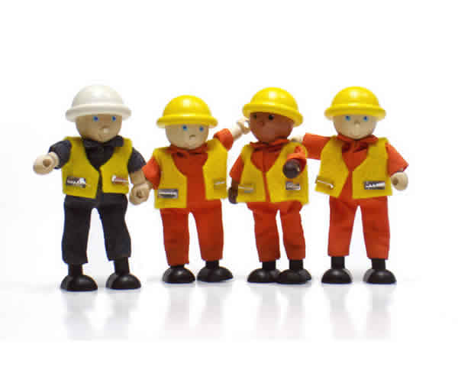
Plymouth City Youth Council
The scientists say that they had been put in charge of the project back home and should be in charge on the island. They say they are cleverer than the workers and therefore more important and important people should lead the others who are only workers.
Notes:
Use the scenario in the powerpoint or a similar one of your choice, to introduce the idea of the creation of a rule system and the mechanisms needed to put rules in place and to enable them to be kept…or not. This is a discussion/dramatised piece that may also need post-it notes, paper and pens to collect ideas.
The class should split into two groups and identify as workers and their families or the scientists, who do not have family members with them.
Key word to explore prior to the lesson: colony – this should have been a key word in the Mayflower story, itself that this work set assumes the children have already engaged with.

Slide 7
Plymouth City Youth Council
Arguments last for days until both groups meet and decide to write up a document that will help them to live together.
Recreate the arguments in pairs/groups/ 2 large groups.
Notes:
Use the scenario in the Powerpoint or a similar one of your choice, to introduce the idea of the creation of a rule system and the mechanisms needed to put rules in place and to enable them to be kept…or not. This is a discussion/dramatised piece that may also need post-it notes, paper and pens to collect ideas.
The class should split into two groups and identify as workers and their families or the scientists, who do not have family members with them.
Key word to explore prior to the lesson: colony – this should have been a key word in the Mayflower story, itself that this work set assumes the children have already engaged with.

Slide 8
Plymouth City Youth Council
Hold a meeting where the 2 groups discuss and vote on an answer to each of the following questions (provide the questions on flash cards):
Notes:
Use the scenario in the PowerPoint or a similar one of your choice, to introduce the idea of the creation of a rule system and the mechanisms needed to put rules in place and to enable them to be kept…or not. This is a discussion/dramatised piece that may also need post-it notes, paper and pens to collect ideas.
The class should split into two groups and identify as workers and their families or the scientists, who do not have family members with them.
Key word to explore prior to the lesson: colony – this should have been a key word in the Mayflower story, itself that this work set assumes the children have already engaged with.

Slide 9
Flashcard options
How can the colonists enforce the rules?
Plymouth City Youth Council
Should there be a single leader or a group of leaders? Who should this be and why?
How do the colonist make sure everyone works hard
How should the leader or leaders be selected?
What happens if rules are broken and who decides what happens?
Who should make the rules? How are these people chosen?
Should there be a single leader or a group of leaders? Who should this be and why?
Notes:
Use the statements or create them as flashcards for discussion.

Slide 10
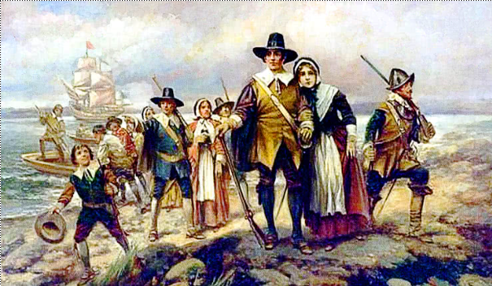
Plymouth City Youth Council
Reflect on the Mayflower story; they had to make rules as they argued at first. What have we found out about making rules?
How do you think the Mayflower I colonists made their rules in Plymouth Massachusetts and what rules do you think they made?
Notes:
At the end of the session: At the end of the session, recap the experiences of the learning opportunity…what have we found out about making rules? Reflect on the Mayflower story; they had to make rules as they argued at first. Pose a link question for the next session: how do you think the Mayflower I colonists made their rules in Plymouth Massachusetts and what rules do you think they made?

Slide 11
Plymouth City Youth Council
The Plymouth Mayflower 400
Citizenship Project: Session 2: The Mayflower Compact
Your city; your school; your future; your
Notes:
Recap on the previous session. What did the class learn about making rules? Given they know the Mayflower story, how do they think the Pilgrims/Strangers made their rules? What rules have they come up with that they think the Pilgrims/Strangers may have made? List these. Remember to ensure the children evidence the rule making process – why these rules?
Introduce the key words: compact. What does compact mean? (pushed together/dense). Covenant (agreement). Introduce the use of the word compact to describe the Plymouth colonist’s set of rules that they also refer to as a covenant. Introduce the compact and examine what it says. There are options to translate to modern English or just share the translation.
‘Unpack’ the rules as you feel appropriate. What does each mean? What is a loyal subject? What does self-governance mean? What does the Christian faith of the 1600s say about how to live our lives? What did the colonists mean by ‘create one society’? (Remember the Native American people were living close by.) What does create and enact mean? How could they interpret ‘for the good of the colony’?
Have the 4 rules, or simplified versions, on flash cards and compare with the pupil’s suggested rules. Look at similarities and differences and consider why.
Group discussions.
Using the previous session’s questions, and using resources noted in the Mayflower schemes of work, consider the meeting that agreed the compact, the compact itself and how effective it was. Small group work coming together to share their findings:
Did the colonists have a single leader or a group of leaders? Who and why?
How was the leader or leaders selected?
Who made the rules?
How did the colonists enforce the rules?
What happened if rules were broken and who decided what happened?
How do the colonist make sure everyone worked hard to build and develop the colony?
Did everyone have rights/the same rights? Why?
Some Background to help: (more links can be found within the Mayflower schemes of work)
The colony, of over 100 people, were cut off from any government, with a rebellion brewing. If they didn't work as a group, they could all die in the wilderness. The Pilgrim leaders realised that they needed a temporary government authority. Back home, such authority came from the King. Isolated as they were in America, it could only come from the people themselves. Aboard the Mayflower, by necessity, the Pilgrims and "Strangers" made a written agreement or compact among themselves. The Compact was probably composed by William Brewster, who had a university education, and was signed by nearly all the adult male colonists, including two of the indentured servants. The format of the Mayflower Compact is very similar to the written agreements used by the Pilgrims to establish their Separatist churches in England and Holland. Under these agreements the male adult members of each church decided how to worship God. They also elected their own ministers and other church officers. This pattern of church self-government served as a model for political self-government in the Mayflower Compact. The colonists had no intention of declaring their independence from England when they signed the Mayflower Compact. In the opening line of the Compact, both Pilgrims and "Strangers" refer to themselves as "loyal subjects" of King James. The rest of the Mayflower Compact is very short. It simply bound the signers into a "Civil Body Politic" for the purpose of passing "just and equal Laws . . . for the general good of the Colony." But those few words expressed the idea of self-government for the first time in the New World.
Immediately after agreeing to the Mayflower Compact, the signers elected John Carver (one of the Pilgrim leaders) as governor of their colony. They called it Plymouth Plantation. When Governor Carver died in less than a year, William Bradford replaced him. Each year after this the "Civil Body Politic," consisting of all adult males, except indentured servants, assembled to elect the governor and a small number of assistants. Bradford was re-elected 30 times between 1621 and 1656. In the early years Governor Bradford decided how the colony should be run. Few objected to his one-man rule. As the colony's population grew, due to immigration, several new towns came into existence. The roving and increasingly scattered population found it difficult to attend the General Court, as the governing meetings at Plymouth came to be called. By 1639, deputies were sent to represent each town at the other General Court sessions. Not only self-rule, but representative government had taken root on American soil.
Draw together thinking from the dramatised experience of creating a set of rules and how this was similar/different to the way the pupils have researched that it may have happened for the Mayflower settlers. What are the main issues when making rules for a community? Prioritise and list these, ready for the next session.
N.B. Throughout the exploration of the Mayflower story, it will be important to emphasise a pluralistic approach to discussion and to recognise that there are a variety of versions of the Mayflower story and that an accurate picture is not something historians have access to or necessarily agree upon.

Slide 12
Plymouth City Youth Council
Reflect on the Mayflower story from our earlier session . The Pilgrims had to make rules as they argued at first.
What did we learn about making rules?
how do they think the Pilgrims/Strangers made their rules?
Make a list of the rules that the pilgrims/ strangers may have made.

Slide 13
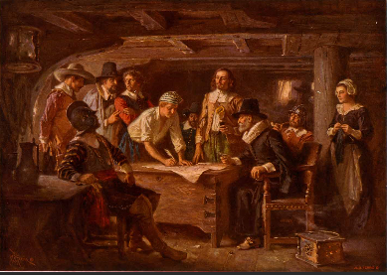
Plymouth City Youth Council
The Mayflower Compact (1620)
In the name of God, Amen. We, whose names are underwritten, the loyal subjects of our dread Sovereign Lord King James, by the Grace of God, of Great Britain, France, and Ireland, King, defender of the Faith, (continued on next slides).

Slide 14
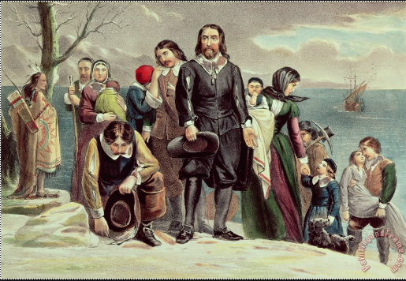
Having undertaken, for the Glory of God, and advancements of the Christian faith and honor of our King and Country, a voyage to plant the first colony in the Northern parts of Virginia, do by these presents, solemnly and mutually, in the presence of God, and one another, covenant and combine ourselves together into a civil body politic; for our better ordering, and preservation and furtherance of the ends aforesaid; and by virtue hereof to enact, constitute, and frame, such just and equal laws, ordinances, acts, constitutions, and offices, from time to time, as shall be thought most meet and convenient for the general good of the colony; unto which we promise all due submission and obedience.
Plymouth City Youth Council

Slide 15
Plymouth City Youth Council
In witness whereof we have hereunto subscribed our names at Cape Cod the 11th of November, in the year of the reign of our Sovereign Lord King James, of England, France, and Ireland, the eighteenth, and of Scotland the fifty-fourth, 1620.

Slide 16
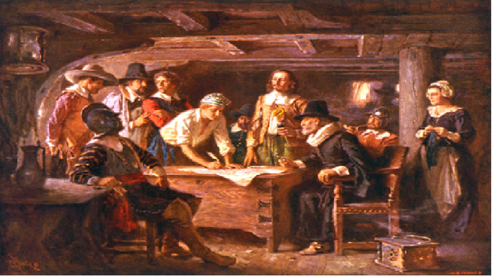
Translation:
We pray to god as we write this. Those of us who signed are subjects of King James. We are also subjects of god. We came here for God, for Christianity, for the king, and for England. We are on a voyage to put a colony into the northern parts of Virginia. Since god agrees, we all agree to work together in this new land. We will work together to make ourselves better, and to last longer. We will make laws that we think are the best for the colony, and we promise to follow these laws completely.
We sign today, at Cape Cod, November 11th, 1620, under the control of King James.
Plymouth City Youth Council

Slide 17
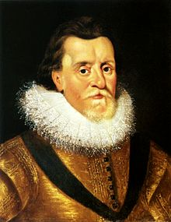
Plymouth City Youth Council
In short, the compact says this:
the colonists would remain loyal subjects to King James, despite their need for self-governance
the colonists would live in accordance with the Christian faith
the colonists would create one society and work together to further it
the colonists would create and enact “laws, ordinances, acts, constitutions and offices…” for the good of the colony, and abide by those laws.

Slide 18
Plymouth City Youth Council
Think about the Compact ( four rules) that the pilgrims/ strangers made.
What do you think each of them mean?
What is a loyal subject?
What does self-governance mean?
What does the Christian faith of the 1600s say about how to live our lives?
What did the colonists (pilgrims/ strangers) mean by ‘create one society’? (Remember the Native American people were living close by.)
What does create and enact mean?
What do you think that the colonists/pilgrims mean by the term ‘for the good of the colony’
Notes:
Use all or select options to discuss.

Slide 19
Group 1:
the colonists would remain loyal subjects to King James, despite their need for self-governance
Plymouth City Youth Council
Group 2:
the colonists would live in accordance with the Christian faith
Group 3:
the colonists would create one society and work together to further it
Group 4:
the colonists would create and enact “laws, ordinances, acts, constitutions and offices…” for the good of the colony, and abide by those laws.

Slide 20
Plymouth City Youth Council
Consider the Pilgrims/colonists meeting that agreed the compact, the compact itself and how effective it was. Let’s bring our ideas together, to share our findings.
Did the colonists have a single leader or a group of leaders? Who and why?
How was the leader or leaders selected?
Who made the rules?
How did the colonists enforce the rules?
What happened if rules were broken and who decided what happened?
How do the colonist make sure everyone worked hard to build and develop the colony?
Did everyone have rights/the same rights? Why?

Slide 21
Plymouth City Youth Council
The Plymouth Mayflower 400
Citizenship Project: Session 3: How are rules (laws) made today? (2020)
Your city; your school; your future; your

Slide 22
Plymouth City Youth Council
In sessions one and two, we looked at how the travellers on the Mayflower needed to make a compact ( set of rules) to stop them from arguing when they were shipwrecked in the new lands.
In your groups, have a discussion to find out what the four main rules of the Compact were.

Slide 23
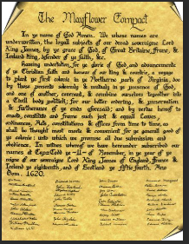
Plymouth City Youth Council
1) the colonists would remain loyal subjects to King James, despite their need for self-governance
2) the colonists would live in accordance with the Christian faith.
3) the colonists would create one society and work together to further it.
4) the colonists would create and enact “laws, ordinances, acts, constitutions and offices…” for the good of the colony, and abide by those laws.

Slide 24
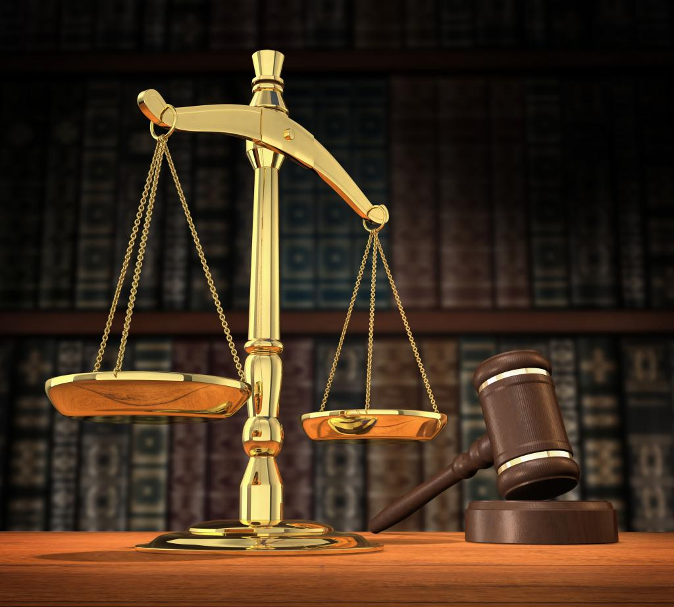
How are laws (rules) made today?
Laws are rules that everyone in the country must obey. In a democracy, like the UK, nobody is above the law. About one hundred new laws are passed each year by the UK Parliament.
Plymouth City Youth Council

Slide 25
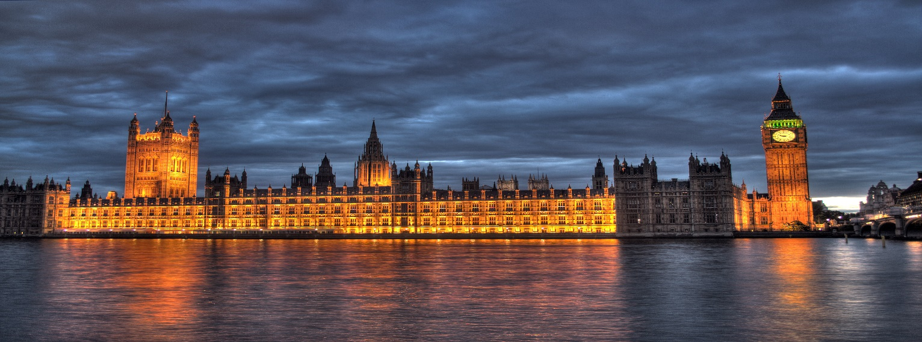
What is Parliament?
Parliament is made up of people that have been voted for by ordinary people in their local communities, (called constituencies). This usually happens during a general election.
Every five years, in the UK, the people get to decide who they would like to represent their views in Parliament. The people that are elected are called Members of Parliament or MP for short.
Plymouth City Youth Council

Slide 26
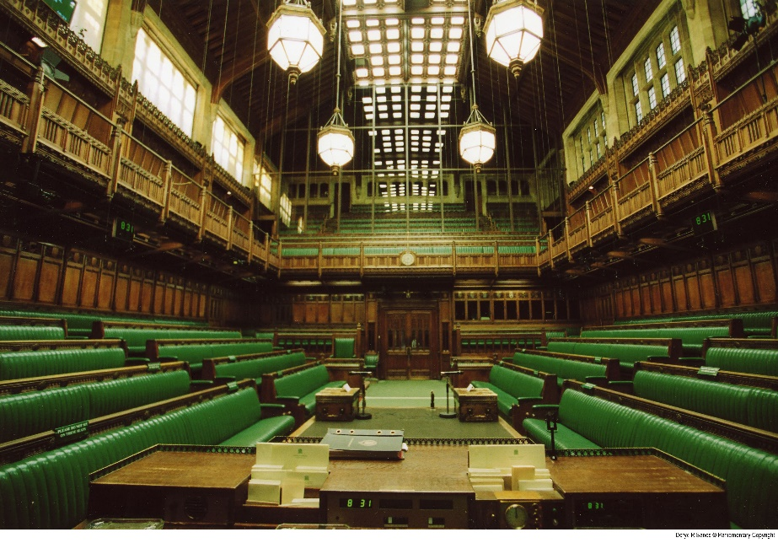
What is the difference between Parliament and Government?
After a general election , the party with the most votes, in most constituencies, will be asked, by the Queen, to form a government.
The Leader of the winning party will become the Prime Minister; he/she will decide which MPs, in their party, will be employed in the government. Some MPs will be asked to be ministers or secretaries of state. The Prime Minister will also ask ministers to join the cabinet. This is a group that helps the Prime Minister to run the government. Their job includes making proposals to Parliament to make new laws. These proposals are called BILLS.
Plymouth City Youth Council

Slide 27
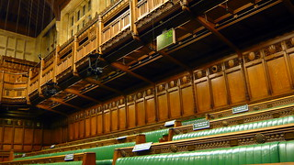
Her Majesties Opposition
After a general election, the party that gets the second highest number of MPs elected into Parliament, will be invited by the Queen to form Her Majesties opposition.
The Leader of the Opposition will invite MPs, from their party ,to join the shadow cabinet. The Job of the shadow cabinet is to mirror or “shadow” the ministers in the government cabinet
Plymouth City Youth Council

Slide 28
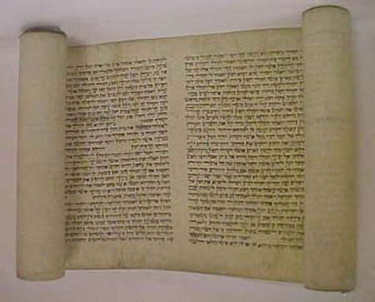
Plymouth City Youth Council
Making new laws:
Even though it is the job of government to make new laws, the government can’t usually make or pass laws by themselves. When government propose a new law, it is called a BILL.
All the other MPs in Parliament will have a chance to propose amendments (changes) to the BILL and vote For or Against the BILL becoming law. This includes members of the second chamber, called the HOUSE OF LORDS

Slide 29
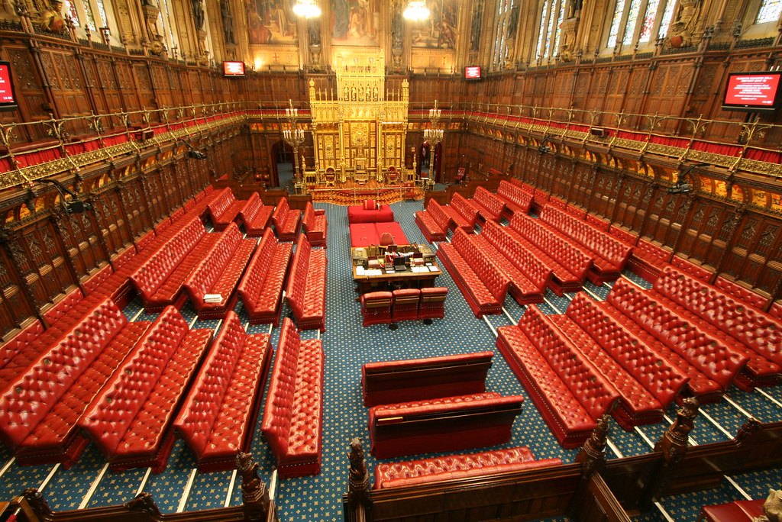
Plymouth City Youth Council
The House of LORDS:
The House of Lords is the second chamber of the UK Parliament. It is independent from the elected House of Commons.
The Lords share the task of making and shaping laws and checking and challenging the work of the government. Members of the House of Lords are appointed by the Queen on the advice of the Prime Minister.

Slide 30
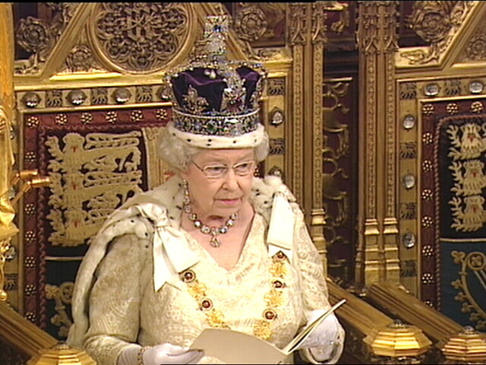
Plymouth City Youth Council
BILLS must be agreed by Parliament, including the House of Lords before they can become LAW
Once the BILL is passed (agreed) it is presented to the Monarch as AN ACT of PARLIAMENT. When the Monarch signs the ACT, then it becomes LAW. This is called Royal Assent.

Slide 31
Think back to the story of the Mayflower 2 How did the crew make their rules?
Think about the 4 rules that were agreed in the first Mayflower Compact, are any of them still relevant today?
How do we make Laws today compared to the Mayflower Compact and those made on Mayflower 2
Plymouth City Youth Council

Slide 32
Plymouth City Youth Council
The Plymouth Mayflower 400
Citizenship Project: Session 4: Developing a Children and Young People’s Plymouth Compact for (2020)
Your city; your school; your future; your

Slide 33
Plymouth City Youth Council
Creating the 2020 Mayflower Convention (compact)
To commemorate the sailing of the Mayflower in 1620, and the signing of the Compact by the crew of the Mayflower, children and young people are invited to create a new Compact that is relevant for children and young people in 2020
The aim of the 2020 Compact is to agree a set of rights and obligations for Children and Young People of Plymouth. This Compact will become an historic document that adds to the Mayflower legacy and story for future generations.
Have a discussion in your groups; What do you think rights and obligations are? How would you describe them?

Slide 34
The United Nations Convention on the Rights of the Child is a set of statements called articles that most countries in the world have signed. The agreement consists of 54 articles that cover four categories of children's rights. (articles listed in Power Point notes) The four basic principles of the Children’s Rights Convention are as follows:
I. PLAYING A PART: OUR RIGHT TOPARTICIPATE
2. REACHING OUR POTENTIAL: OUR RIGHT TO DEVELOP WHO WE ARE
3. LIVING WELL: OUR RIGHT TO SURVIVAL
4. BEING FREE FROM HARM: OUR RIGHT TO PROTECTION
Notes:
Print off the United Nations rights of the Child Poster: Children will need to see this to help them with group work later in the lesson. There are many versions available. Here is a helpful link
https://plan-international.org/sites/default/files/field/field_document/child-friendly_crc_poster_a4_-_final_-_english.pdf
Today the convention has been ratified by 192 countries becoming the most ratified of all international Human Rights treaties. India signed and ratified the convention in 1992. The only two countries who have not ratified the treaty are the United States and Somalia. Somalia has been unable to ratify due to the lack of a stable government and the US has signed the treaty showing their intention to ratify.
The four basic principles of the children’s rights convention. (1)
I. PLAYING A PART: OUR RIGHT TO PARTICIPATE
Article 3 Priority of children’s needs in political decisions, legislation and jurisdiction
Article 12 Freedom of opinion and the right to be heard in all personal matters
Article 13 Freedom of expression
Article 14 Freedom of thought, conscience and religion
Article 15 Right of association and peaceful demonstration in public
Article 16 Protection of privacy
Article 17 Access to media and sources of information
II. REACHING OUR POTENTIAL: OUR RIGHT TO DEVELOP WHO WE ARE
Article 5 Protection of the rights of parents
Article 7 Protection of a child’s name and nationality
Article 8 Protection of a child’s identity
Article 10 Facilitation of family reunification
Article 21 Monitoring of child adoption
Article 23 Special care for disabled young people
Article 28 Right to education
III. LIVING WELL: OUR RIGHT TO SURVIVAL
Article 6 Protection of survival and development
Article 9 Principle of non-separation from parents
Article 18 Responsibility of parents and guardians
Article 24 Protection of health and access to health care
Article 26 Social security
Article 27 Adequate living standards
Article 31 Right to rest and leisure
IV. BEING FREE FROM HARM: OUR RIGHT TO PROTECTION
Article 2 Principle of non-discrimination
Article 11 Protection from kidnapping and abduction
Article 19 Protection from abuse and neglect
Article 20 Care for young people without families
Article 22 Protection of child refugees
Article 32 Protection from economic exploitation
Article 33 Protection from drugs
Article 34 Protection from sexual exploitation
Article 35 Protection from sale and trafficking
Article 36 Protection from all other forms of exploitation
Article 37 Protection from torture and cruel treatment
Article 38 Wars and armed conflicts
Article 39 Social reintegration of child victims
Article 40 Treatment of children by penal law
__________
1. This is an excerpt from: Say It Right! The Unconventional Canadian Youth Edition of the United Nations Convention
on the Rights of the Child.
The Following is an overview of the Full United Nations Convention on the Rights of the Child.
Preamble: Recognises many of the principles outlines in the Declaration on the Rights of the Child such as family as the best environment for a child to grow, the importance of child protection, best interest of the child, recognising child participation, etc.
Article 1: According to the convention a child is any person how has not reached the age of eighteen unless a different age of maturity is specified in any country's law.
Article2: It is the duty of the state (each country) to uphold the articles in the convention and apply it to all children regardless of the child's or the family's race, colour, sex, language, religion, political or other opinion, national, ethnic or social origin, property, disability, birth or other status. The state should protect the child against all forms of discrimination.
Article 3: the state will always act in the best interest of the child while taking into consideration the rights and duties of the guardians. The state shall ensure all institutions government or not adhere to this dictum.
Article 4: The state must make laws, implement policies and programmes and undertake other measures to unsure the rights set out in the convention are fulfilled.
Article 5: The state will keep in mind the rights of the guardians of the child or any other family member or community as in accordance with local customs
Article 6: States recognise that every child has the inherent right to life, and must work to ensure the survival and development of the child.
Article 7: Every child has the right to a name, birth registration and nationality. As far as possible every child has the right to know and be cared for by his/her parents. The state should make laws and provisions especially for stateless children.
Article 8: A child has the right to preserve his/her identity including nationality, name and family relations without unlawful interference.
Article 9: Every child has the right not to be separated from their parents against his/her will unless it is in his/her best interest. Any legal proceeding of separation shall be attended by all involved parties including the parents. The right has the right to maintain contact with his/her parent as long as it's not against his/her best interest. If the state is the cause of separation than the parents, child or any other family member has the right to know the whereabouts of the absent member.
Article 10: Every child and family has the right to enter or leave a state at any time they wish as long as it is in accordance with the laws of each state. If a child is in the different state as the parents the child has the right to maintain contact with his/her parent as long as it's not against his/her best interest
Article 11: The state shall combat child trafficking.
Article 12: The state shall ensure the child's right to form and express views with regard to things that affect him/her in accordance with the maturity and age of the child. A child shall hence we allowed to be heard in any judicial proceeding concerning the child directly or indirectly through a representative
Article 13: Children have a right to free expression and this includes right to information and ideas of all kinds and in any medium. This is only restricted by the violation of others rights or a threat to national security.
Article 14: Every child has the right to freedom of thought, conscience and religion. The state must respect the parents' right to guide the child in this regard. Freedom to manifest ones religion is only restricted if the act is harmful to others.
Article 15: Every child has the right to freedom of association and peaceful assembly unless the act is illegal or harmful to others.
Article 16: Children have the right to privacy and the right to be protected by law against such interference of attacks
Article 17: The state shall ensure that a child has access to national and international information that is aimed at the child's well being. For example they may encourage mass media to produce programmes that are informational for children and encourage the production of children's books and magazines.
Article 18: The state shall ensure the recognition of responsibility of both parents to care for a child as long as it is in her/his best interest. The state shall give appropriate guidance and assistance to parents to uphold the rights of the child. Children of working parents have the right to access child-care services.
Article 19: The state shall take all types of actions to protect the child from any form of abuse, exploitation or neglect. The state shall create system to ensure the child receives all needed support in form of prevention, protection and rehabilitation.
Article 20: Children have the right to protection by the state when they temporarily or permanently deprived of their family environment or if the environment has proven to be harmful for them. The state shall find alternate care for the child such as foster care, adoption or kafalah of Islamic law. The cultural, linguistic and religious background of the child should be continued as far as possible.
Article 21: All states shall permit and recognise the process of adoption. Adoption will be carried out only by a competent authority who will sure the adoption is permissible. Inter-country adoption will be permitted as an alter form of care only if that care cannot be provided for in the child's own country. The state must ensure that inter-country adoption does not result in financial gain, and that both national and international adoption is held to the same safeguards and standards.
Article 22: Children seeking refugee status and recognised as refuges with or without their parents shall be granted such a status by the state and have the same rights as all children in accordance with this convention and any other human rights treaty. The state shall with the assistance of other international bodies try and reunite the child with his family or provide the child with the appropriate care.
Article 23: States recognise that children with disabilities (mental or physical) have the right to a life with dignity and all other rights of this convention. The State also recognises the need to provide children with disabilities with special care, family assistance, free education, health, training, etc in accordance with the family's financial situation and aim for the child's social integration. The state shall also take measure to prevent the disabilities in children.
Article 24: Every child has the right to access health services and attain the highest degree of health. To do so the state shall reduce the infant mortality rate, ensure medical assistance, provide prenatal and post natal care of mothers and child, combat diseases and malnutrition, create awareness of correct health practises, and development preventive measure to protect children from possible risks. The state shall also abolish all traditional practises detrimental to a child's health.
Article 25: All treatments administered to children are subject to periodic review.
Article 26: Every child has the right to social security and social insurance. Benefits under state laws should take into account the economic and social needs of the families.
Article 27: Every child has the right to a standard of living required for his/her development. Parents have the duty to ensure this standard to the best of their ability. The state shall assist parents or others responsible for the child who require the help, and secure the maintenance of the child from those financially responsible within the state or abroad.
Article 28: All children have the right to education. The state shall endeavour to provide free primary education, encourage different forms of secondary education, make higher forms of education accessible, make vocational information available and encourage school retention and prevent drop outs. School discipline should not be in violation of child rights.
Article 29: Child education should be geared towards the complete development of the child, in accordance with the child's cultural identity and human rights treaties, and to prepare the child for responsible life in society. It should not be detrimental to the environment. People may be allowed to establish educational institutes in accordance with these standards.
Article 30: Children of minority communities have the right to practise and adopt the culture, languages and traditions of their community.
Article 31: Every child has the right to leisure, play and participation in cultural events. The state should encourage child participation in such events.
Article 32: Children have the right to be protected from economic exportation or any work that is harmful to their physical and mental development or considered hazardous or dangerous work. The state must constitute a day that dictates minimum age of employment, conditions of employment and hours of employment with regards to children.
Article 33: The state should take measure to protect children from substance abuse and prevent the use of children in the illegal trafficking of such substances.
Article 34: Every child has the right to be protected from sexual exploitation and sexual abuse. The state must hence prevent the coercion and prostitution of children for such activities as well as safeguard children from pornographic performances and materials.
Article 35: States shall take measure to prevent the abduction or sale of children for any purpose.
Article 36: The state shall protect children against any other form of exploitation.
Article 37: The state shall ensure that no child is subject to torture or any other cruel inhuman treatment, no child is deprived of his liberty unlawfully, and a child deprived of his liberty is entitled to proper care and humane circumstances, and be provided with legal consult if necessary.
Article 38: The state ensures and respects the rules of humanitarian law during times of conflict. The state should also ensure that children below 15 do no participate in the hostilities, and refrain from recruiting them in armed forces.
Article 39: The state should ensure the recovery, rehabilitation and reintegration of child victims of neglect, exploitation, or abuse, etc.
Article 40: The state shall recognise the right of every child who has committed a crime under the law to a proper care and reintegration into society. No child shall be accused or penalised for an act which is not a recognised crime. A child who has been accused of a crime are presumed innocent, should be informed of the charges against him/her, have the juvenile justice proceeding immediately without delay, not be compelled to give testimony or admit guilt and the right to privacy of all proceedings. States should endeavour to establish laws specifically catered to the needs of children who have been accused or found guilty of any criminal activity and establish a minimum age of guilt.
Article 41: The articles of this convention will not take priority over any laws national or intentional that better safeguard the rights of a child.
Articles 42-54: outline the establishment, composition and responsibilities of the Committee on the Rights of the Child.

Slide 35
Plymouth City Youth Council
Think about The United Nations Convention on the Rights of the Child.
What do you think each of them mean?
Are there any articles that are similar to the Mayflower Compact?
Can you think of any articles that are missing from the convention (Compact)? that are important rights for children and young people today?
Notes:
Today the convention has been ratified by 192 countries becoming the most ratified of all international Human Rights treaties. India signed and ratified the convention in 1992. The only two countries who have not ratified the treaty are the United States and Somalia. Somalia has been unable to ratify due to the lack of a stable government and the US has signed the treaty showing their intention to ratify.
The four basic principles of the children’s rights convention. (1)
I. PLAYING A PART: OUR RIGHT TO PARTICIPATE
Article 3 Priority of children’s needs in political decisions, legislation and jurisdiction
Article 12 Freedom of opinion and the right to be heard in all personal matters
Article 13 Freedom of expression
Article 14 Freedom of thought, conscience and religion
Article 15 Right of association and peaceful demonstration in public
Article 16 Protection of privacy
Article 17 Access to media and sources of information
II. REACHING OUR POTENTIAL: OUR RIGHT TO DEVELOP WHO WE ARE
Article 5 Protection of the rights of parents
Article 7 Protection of a child’s name and nationality
Article 8 Protection of a child’s identity
Article 10 Facilitation of family reunification
Article 21 Monitoring of child adoption
Article 23 Special care for disabled young people
Article 28 Right to education
III. LIVING WELL: OUR RIGHT TO SURVIVAL
Article 6 Protection of survival and development
Article 9 Principle of non-separation from parents
Article 18 Responsibility of parents and guardians
Article 24 Protection of health and access to health care
Article 26 Social security
Article 27 Adequate living standards
Article 31 Right to rest and leisure
IV. BEING FREE FROM HARM: OUR RIGHT TO PROTECTION
Article 2 Principle of non-discrimination
Article 11 Protection from kidnapping and abduction
Article 19 Protection from abuse and neglect
Article 20 Care for young people without families
Article 22 Protection of child refugees
Article 32 Protection from economic exploitation
Article 33 Protection from drugs
Article 34 Protection from sexual exploitation
Article 35 Protection from sale and trafficking
Article 36 Protection from all other forms of exploitation
Article 37 Protection from torture and cruel treatment
Article 38 Wars and armed conflicts
Article 39 Social reintegration of child victims
Article 40 Treatment of children by penal law
__________
1. This is an excerpt from: Say It Right! The Unconventional Canadian Youth Edition of the United Nations Convention
on the Rights of the Child.
The Following is an overview of the Full United Nations Convention on the Rights of the Child.
Preamble: Recognises many of the principles outlines in the Declaration on the Rights of the Child such as family as the best environment for a child to grow, the importance of child protection, best interest of the child, recognising child participation, etc.
Article 1: According to the convention a child is any person how has not reached the age of eighteen unless a different age of maturity is specified in any country's law.
Article2: It is the duty of the state (each country) to uphold the articles in the convention and apply it to all children regardless of the child's or the family's race, colour, sex, language, religion, political or other opinion, national, ethnic or social origin, property, disability, birth or other status. The state should protect the child against all forms of discrimination.
Article 3: the state will always act in the best interest of the child while taking into consideration the rights and duties of the guardians. The state shall ensure all institutions government or not adhere to this dictum.
Article 4: The state must make laws, implement policies and programmes and undertake other measures to unsure the rights set out in the convention are fulfilled.
Article 5: The state will keep in mind the rights of the guardians of the child or any other family member or community as in accordance with local customs
Article 6: States recognise that every child has the inherent right to life, and must work to ensure the survival and development of the child.
Article 7: Every child has the right to a name, birth registration and nationality. As far as possible every child has the right to know and be cared for by his/her parents. The state should make laws and provisions especially for stateless children.
Article 8: A child has the right to preserve his/her identity including nationality, name and family relations without unlawful interference.
Article 9: Every child has the right not to be separated from their parents against his/her will unless it is in his/her best interest. Any legal proceeding of separation shall be attended by all involved parties including the parents. The right has the right to maintain contact with his/her parent as long as it's not against his/her best interest. If the state is the cause of separation than the parents, child or any other family member has the right to know the whereabouts of the absent member.
Article 10: Every child and family has the right to enter or leave a state at any time they wish as long as it is in accordance with the laws of each state. If a child is in the different state as the parents the child has the right to maintain contact with his/her parent as long as it's not against his/her best interest
Article 11: The state shall combat child trafficking.
Article 12: The state shall ensure the child's right to form and express views with regard to things that affect him/her in accordance with the maturity and age of the child. A child shall hence we allowed to be heard in any judicial proceeding concerning the child directly or indirectly through a representative
Article 13: Children have a right to free expression and this includes right to information and ideas of all kinds and in any medium. This is only restricted by the violation of others rights or a threat to national security.
Article 14: Every child has the right to freedom of thought, conscience and religion. The state must respect the parents' right to guide the child in this regard. Freedom to manifest ones religion is only restricted if the act is harmful to others.
Article 15: Every child has the right to freedom of association and peaceful assembly unless the act is illegal or harmful to others.
Article 16: Children have the right to privacy and the right to be protected by law against such interference of attacks
Article 17: The state shall ensure that a child has access to national and international information that is aimed at the child's well being. For example they may encourage mass media to produce programmes that are informational for children and encourage the production of children's books and magazines.
Article 18: The state shall ensure the recognition of responsibility of both parents to care for a child as long as it is in her/his best interest. The state shall give appropriate guidance and assistance to parents to uphold the rights of the child. Children of working parents have the right to access child-care services.
Article 19: The state shall take all types of actions to protect the child from any form of abuse, exploitation or neglect. The state shall create system to ensure the child receives all needed support in form of prevention, protection and rehabilitation.
Article 20: Children have the right to protection by the state when they temporarily or permanently deprived of their family environment or if the environment has proven to be harmful for them. The state shall find alternate care for the child such as foster care, adoption or kafalah of Islamic law. The cultural, linguistic and religious background of the child should be continued as far as possible.
Article 21: All states shall permit and recognise the process of adoption. Adoption will be carried out only by a competent authority who will sure the adoption is permissible. Inter-country adoption will be permitted as an alter form of care only if that care cannot be provided for in the child's own country. The state must ensure that inter-country adoption does not result in financial gain, and that both national and international adoption is held to the same safeguards and standards.
Article 22: Children seeking refugee status and recognised as refuges with or without their parents shall be granted such a status by the state and have the same rights as all children in accordance with this convention and any other human rights treaty. The state shall with the assistance of other international bodies try and reunite the child with his family or provide the child with the appropriate care.
Article 23: States recognise that children with disabilities (mental or physical) have the right to a life with dignity and all other rights of this convention. The State also recognises the need to provide children with disabilities with special care, family assistance, free education, health, training, etc in accordance with the family's financial situation and aim for the child's social integration. The state shall also take measure to prevent the disabilities in children.
Article 24: Every child has the right to access health services and attain the highest degree of health. To do so the state shall reduce the infant mortality rate, ensure medical assistance, provide prenatal and post natal care of mothers and child, combat diseases and malnutrition, create awareness of correct health practises, and development preventive measure to protect children from possible risks. The state shall also abolish all traditional practises detrimental to a child's health.
Article 25: All treatments administered to children are subject to periodic review.
Article 26: Every child has the right to social security and social insurance. Benefits under state laws should take into account the economic and social needs of the families.
Article 27: Every child has the right to a standard of living required for his/her development. Parents have the duty to ensure this standard to the best of their ability. The state shall assist parents or others responsible for the child who require the help, and secure the maintenance of the child from those financially responsible within the state or abroad.
Article 28: All children have the right to education. The state shall endeavour to provide free primary education, encourage different forms of secondary education, make higher forms of education accessible, make vocational information available and encourage school retention and prevent drop outs. School discipline should not be in violation of child rights.
Article 29: Child education should be geared towards the complete development of the child, in accordance with the child's cultural identity and human rights treaties, and to prepare the child for responsible life in society. It should not be detrimental to the environment. People may be allowed to establish educational institutes in accordance with these standards.
Article 30: Children of minority communities have the right to practise and adopt the culture, languages and traditions of their community.
Article 31: Every child has the right to leisure, play and participation in cultural events. The state should encourage child participation in such events.
Article 32: Children have the right to be protected from economic exportation or any work that is harmful to their physical and mental development or considered hazardous or dangerous work. The state must constitute a day that dictates minimum age of employment, conditions of employment and hours of employment with regards to children.
Article 33: The state should take measure to protect children from substance abuse and prevent the use of children in the illegal trafficking of such substances.
Article 34: Every child has the right to be protected from sexual exploitation and sexual abuse. The state must hence prevent the coercion and prostitution of children for such activities as well as safeguard children from pornographic performances and materials.
Article 35: States shall take measure to prevent the abduction or sale of children for any purpose.
Article 36: The state shall protect children against any other form of exploitation.
Article 37: The state shall ensure that no child is subject to torture or any other cruel inhuman treatment, no child is deprived of his liberty unlawfully, and a child deprived of his liberty is entitled to proper care and humane circumstances, and be provided with legal consult if necessary.
Article 38: The state ensures and respects the rules of humanitarian law during times of conflict. The state should also ensure that children below 15 do no participate in the hostilities, and refrain from recruiting them in armed forces.
Article 39: The state should ensure the recovery, rehabilitation and reintegration of child victims of neglect, exploitation, or abuse, etc.
Article 40: The state shall recognise the right of every child who has committed a crime under the law to a proper care and reintegration into society. No child shall be accused or penalised for an act which is not a recognised crime. A child who has been accused of a crime are presumed innocent, should be informed of the charges against him/her, have the juvenile justice proceeding immediately without delay, not be compelled to give testimony or admit guilt and the right to privacy of all proceedings. States should endeavour to establish laws specifically catered to the needs of children who have been accused or found guilty of any criminal activity and establish a minimum age of guilt.
Article 41: The articles of this convention will not take priority over any laws national or intentional that better safeguard the rights of a child.
Articles 42-54: outline the establishment, composition and responsibilities of the Committee on the Rights of the Child.

Slide 36
Plymouth City Youth Council
The Plymouth Mayflower 400
Citizenship Project: Session 5: Our school’s vote for the 2020 Compact
Your city; your school; your future; your

Slide 37
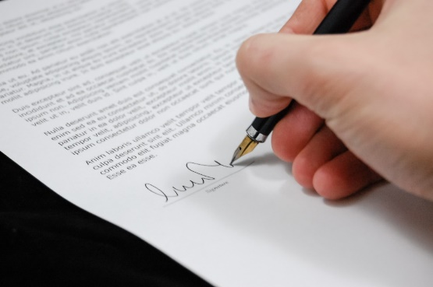
Plymouth City Youth Council
Every school in Plymouth will have an opportunity to have a say about the articles to be included in the 2020 Mayflower Compact. To make sure that it is created fairly, we will follow a democratic process, asking each school to discuss and vote for their top nine articles.
Once every school has voted in their articles, we will invite elected school council/ committee members to attend a City Youth Council meeting in March 2020. Youth Council and Youth Parliament representatives will discuss the articles from each school and vote to decide the final nine articles. These will become the 2020 Mayflower Compact.
Each participating school will be invited to an event, in October 2020, at the Theatre Royal, to sign the Compact, just as the original Mayflower settlers did.
Notes:
Today the convention has been ratified by 192 countries becoming the most ratified of all international Human Rights treaties. India signed and ratified the convention in 1992. The only two countries who have not ratified the treaty are the United States and Somalia. Somalia has been unable to ratify due to the lack of a stable government and the US has signed the treaty showing their intention to ratify.
The four basic principles of the children’s rights convention. (1)
I. PLAYING A PART: OUR RIGHT TO PARTICIPATE
Article 3 Priority of children’s needs in political decisions, legislation and jurisdiction
Article 12 Freedom of opinion and the right to be heard in all personal matters
Article 13 Freedom of expression
Article 14 Freedom of thought, conscience and religion
Article 15 Right of association and peaceful demonstration in public
Article 16 Protection of privacy
Article 17 Access to media and sources of information
II. REACHING OUR POTENTIAL: OUR RIGHT TO DEVELOP WHO WE ARE
Article 5 Protection of the rights of parents
Article 7 Protection of a child’s name and nationality
Article 8 Protection of a child’s identity
Article 10 Facilitation of family reunification
Article 21 Monitoring of child adoption
Article 23 Special care for disabled young people
Article 28 Right to education
III. LIVING WELL: OUR RIGHT TO SURVIVAL
Article 6 Protection of survival and development
Article 9 Principle of non-separation from parents
Article 18 Responsibility of parents and guardians
Article 24 Protection of health and access to health care
Article 26 Social security
Article 27 Adequate living standards
Article 31 Right to rest and leisure
IV. BEING FREE FROM HARM: OUR RIGHT TO PROTECTION
Article 2 Principle of non-discrimination
Article 11 Protection from kidnapping and abduction
Article 19 Protection from abuse and neglect
Article 20 Care for young people without families
Article 22 Protection of child refugees
Article 32 Protection from economic exploitation
Article 33 Protection from drugs
Article 34 Protection from sexual exploitation
Article 35 Protection from sale and trafficking
Article 36 Protection from all other forms of exploitation
Article 37 Protection from torture and cruel treatment
Article 38 Wars and armed conflicts
Article 39 Social reintegration of child victims
Article 40 Treatment of children by penal law
__________
1. This is an excerpt from: Say It Right! The Unconventional Canadian Youth Edition of the United Nations Convention
on the Rights of the Child.
The Following is an overview of the Full United Nations Convention on the Rights of the Child.
Preamble: Recognises many of the principles outlines in the Declaration on the Rights of the Child such as family as the best environment for a child to grow, the importance of child protection, best interest of the child, recognising child participation, etc.
Article 1: According to the convention a child is any person how has not reached the age of eighteen unless a different age of maturity is specified in any country's law.
Article2: It is the duty of the state (each country) to uphold the articles in the convention and apply it to all children regardless of the child's or the family's race, colour, sex, language, religion, political or other opinion, national, ethnic or social origin, property, disability, birth or other status. The state should protect the child against all forms of discrimination.
Article 3: the state will always act in the best interest of the child while taking into consideration the rights and duties of the guardians. The state shall ensure all institutions government or not adhere to this dictum.
Article 4: The state must make laws, implement policies and programmes and undertake other measures to unsure the rights set out in the convention are fulfilled.
Article 5: The state will keep in mind the rights of the guardians of the child or any other family member or community as in accordance with local customs
Article 6: States recognise that every child has the inherent right to life, and must work to ensure the survival and development of the child.
Article 7: Every child has the right to a name, birth registration and nationality. As far as possible every child has the right to know and be cared for by his/her parents. The state should make laws and provisions especially for stateless children.
Article 8: A child has the right to preserve his/her identity including nationality, name and family relations without unlawful interference.
Article 9: Every child has the right not to be separated from their parents against his/her will unless it is in his/her best interest. Any legal proceeding of separation shall be attended by all involved parties including the parents. The right has the right to maintain contact with his/her parent as long as it's not against his/her best interest. If the state is the cause of separation than the parents, child or any other family member has the right to know the whereabouts of the absent member.
Article 10: Every child and family has the right to enter or leave a state at any time they wish as long as it is in accordance with the laws of each state. If a child is in the different state as the parents the child has the right to maintain contact with his/her parent as long as it's not against his/her best interest
Article 11: The state shall combat child trafficking.
Article 12: The state shall ensure the child's right to form and express views with regard to things that affect him/her in accordance with the maturity and age of the child. A child shall hence we allowed to be heard in any judicial proceeding concerning the child directly or indirectly through a representative
Article 13: Children have a right to free expression and this includes right to information and ideas of all kinds and in any medium. This is only restricted by the violation of others rights or a threat to national security.
Article 14: Every child has the right to freedom of thought, conscience and religion. The state must respect the parents' right to guide the child in this regard. Freedom to manifest ones religion is only restricted if the act is harmful to others.
Article 15: Every child has the right to freedom of association and peaceful assembly unless the act is illegal or harmful to others.
Article 16: Children have the right to privacy and the right to be protected by law against such interference of attacks
Article 17: The state shall ensure that a child has access to national and international information that is aimed at the child's well being. For example they may encourage mass media to produce programmes that are informational for children and encourage the production of children's books and magazines.
Article 18: The state shall ensure the recognition of responsibility of both parents to care for a child as long as it is in her/his best interest. The state shall give appropriate guidance and assistance to parents to uphold the rights of the child. Children of working parents have the right to access child-care services.
Article 19: The state shall take all types of actions to protect the child from any form of abuse, exploitation or neglect. The state shall create system to ensure the child receives all needed support in form of prevention, protection and rehabilitation.
Article 20: Children have the right to protection by the state when they temporarily or permanently deprived of their family environment or if the environment has proven to be harmful for them. The state shall find alternate care for the child such as foster care, adoption or kafalah of Islamic law. The cultural, linguistic and religious background of the child should be continued as far as possible.
Article 21: All states shall permit and recognise the process of adoption. Adoption will be carried out only by a competent authority who will sure the adoption is permissible. Inter-country adoption will be permitted as an alter form of care only if that care cannot be provided for in the child's own country. The state must ensure that inter-country adoption does not result in financial gain, and that both national and international adoption is held to the same safeguards and standards.
Article 22: Children seeking refugee status and recognised as refuges with or without their parents shall be granted such a status by the state and have the same rights as all children in accordance with this convention and any other human rights treaty. The state shall with the assistance of other international bodies try and reunite the child with his family or provide the child with the appropriate care.
Article 23: States recognise that children with disabilities (mental or physical) have the right to a life with dignity and all other rights of this convention. The State also recognises the need to provide children with disabilities with special care, family assistance, free education, health, training, etc in accordance with the family's financial situation and aim for the child's social integration. The state shall also take measure to prevent the disabilities in children.
Article 24: Every child has the right to access health services and attain the highest degree of health. To do so the state shall reduce the infant mortality rate, ensure medical assistance, provide prenatal and post natal care of mothers and child, combat diseases and malnutrition, create awareness of correct health practises, and development preventive measure to protect children from possible risks. The state shall also abolish all traditional practises detrimental to a child's health.
Article 25: All treatments administered to children are subject to periodic review.
Article 26: Every child has the right to social security and social insurance. Benefits under state laws should take into account the economic and social needs of the families.
Article 27: Every child has the right to a standard of living required for his/her development. Parents have the duty to ensure this standard to the best of their ability. The state shall assist parents or others responsible for the child who require the help, and secure the maintenance of the child from those financially responsible within the state or abroad.
Article 28: All children have the right to education. The state shall endeavour to provide free primary education, encourage different forms of secondary education, make higher forms of education accessible, make vocational information available and encourage school retention and prevent drop outs. School discipline should not be in violation of child rights.
Article 29: Child education should be geared towards the complete development of the child, in accordance with the child's cultural identity and human rights treaties, and to prepare the child for responsible life in society. It should not be detrimental to the environment. People may be allowed to establish educational institutes in accordance with these standards.
Article 30: Children of minority communities have the right to practise and adopt the culture, languages and traditions of their community.
Article 31: Every child has the right to leisure, play and participation in cultural events. The state should encourage child participation in such events.
Article 32: Children have the right to be protected from economic exportation or any work that is harmful to their physical and mental development or considered hazardous or dangerous work. The state must constitute a day that dictates minimum age of employment, conditions of employment and hours of employment with regards to children.
Article 33: The state should take measure to protect children from substance abuse and prevent the use of children in the illegal trafficking of such substances.
Article 34: Every child has the right to be protected from sexual exploitation and sexual abuse. The state must hence prevent the coercion and prostitution of children for such activities as well as safeguard children from pornographic performances and materials.
Article 35: States shall take measure to prevent the abduction or sale of children for any purpose.
Article 36: The state shall protect children against any other form of exploitation.
Article 37: The state shall ensure that no child is subject to torture or any other cruel inhuman treatment, no child is deprived of his liberty unlawfully, and a child deprived of his liberty is entitled to proper care and humane circumstances, and be provided with legal consult if necessary.
Article 38: The state ensures and respects the rules of humanitarian law during times of conflict. The state should also ensure that children below 15 do no participate in the hostilities, and refrain from recruiting them in armed forces.
Article 39: The state should ensure the recovery, rehabilitation and reintegration of child victims of neglect, exploitation, or abuse, etc.
Article 40: The state shall recognise the right of every child who has committed a crime under the law to a proper care and reintegration into society. No child shall be accused or penalised for an act which is not a recognised crime. A child who has been accused of a crime are presumed innocent, should be informed of the charges against him/her, have the juvenile justice proceeding immediately without delay, not be compelled to give testimony or admit guilt and the right to privacy of all proceedings. States should endeavour to establish laws specifically catered to the needs of children who have been accused or found guilty of any criminal activity and establish a minimum age of guilt.
Article 41: The articles of this convention will not take priority over any laws national or intentional that better safeguard the rights of a child.
Articles 42-54: outline the establishment, composition and responsibilities of the Committee on the Rights of the Child.

Slide 38
Plymouth City Youth Council
Discussing and deciding our schools top nine articles for the 2020 Mayflower compact:
Each class have a discussion and create a mind map of different rights and obligations that you think are important for Plymouth children and young people You can add as many ideas as you like on the mind map.
You may wish to use the grid on the next slide to help you.

Slide 39
Deciding our school’s top nine articles for the 2020 Mayflower compact:
1: Take another look at the articles (statements) in the United Nations ‘Rights of the Child’ Poster that was shown earlier in the lesson. Are any articles still important to children and young people today? | 2: Make a list of any articles that you think are still important and any that you think are no longer important. Discuss in your group why you believe some remain important and why some may no longer be important.
3: Have a discussion in your group. Are There any articles that are important for Plymouth children and young people that are not included in the United Nations ‘ Rights of the Child’ conventions? ( poster) | 4: Bring your ideas and recommendations together and, when asked by your teacher, add them to the whole class mind map.
What do your constituents (other pupils in your school) say about the

Slide 40
Plymouth City Youth Council
Voting in our classes top nine proposals for the 2020 Mayflower Compact.
Once your class has completed your whole class mind map, your teacher will give each group a diamond nine grid. Take a look at the whole class mind map again and decide, in your groups, which nine articles you would prioritise and write into your grid.
Don’t forget to add your class names into the grid.
Once your class has completed the grids, your teacher will collect up the diamond nine grids and class mind maps for the next pat of the voting process.
Notes:
Today the convention has been ratified by 192 countries becoming the most ratified of all international Human Rights treaties. India signed and ratified the convention in 1992. The only two countries who have not ratified the treaty are the United States and Somalia. Somalia has been unable to ratify due to the lack of a stable government and the US has signed the treaty showing their intention to ratify.
The four basic principles of the children’s rights convention. (1)
I. PLAYING A PART: OUR RIGHT TO PARTICIPATE
Article 3 Priority of children’s needs in political decisions, legislation and jurisdiction
Article 12 Freedom of opinion and the right to be heard in all personal matters
Article 13 Freedom of expression
Article 14 Freedom of thought, conscience and religion
Article 15 Right of association and peaceful demonstration in public
Article 16 Protection of privacy
Article 17 Access to media and sources of information
II. REACHING OUR POTENTIAL: OUR RIGHT TO DEVELOP WHO WE ARE
Article 5 Protection of the rights of parents
Article 7 Protection of a child’s name and nationality
Article 8 Protection of a child’s identity
Article 10 Facilitation of family reunification
Article 21 Monitoring of child adoption
Article 23 Special care for disabled young people
Article 28 Right to education
III. LIVING WELL: OUR RIGHT TO SURVIVAL
Article 6 Protection of survival and development
Article 9 Principle of non-separation from parents
Article 18 Responsibility of parents and guardians
Article 24 Protection of health and access to health care
Article 26 Social security
Article 27 Adequate living standards
Article 31 Right to rest and leisure
IV. BEING FREE FROM HARM: OUR RIGHT TO PROTECTION
Article 2 Principle of non-discrimination
Article 11 Protection from kidnapping and abduction
Article 19 Protection from abuse and neglect
Article 20 Care for young people without families
Article 22 Protection of child refugees
Article 32 Protection from economic exploitation
Article 33 Protection from drugs
Article 34 Protection from sexual exploitation
Article 35 Protection from sale and trafficking
Article 36 Protection from all other forms of exploitation
Article 37 Protection from torture and cruel treatment
Article 38 Wars and armed conflicts
Article 39 Social reintegration of child victims
Article 40 Treatment of children by penal law
__________
1. This is an excerpt from: Say It Right! The Unconventional Canadian Youth Edition of the United Nations Convention
on the Rights of the Child.
The Following is an overview of the Full United Nations Convention on the Rights of the Child.
Preamble: Recognises many of the principles outlines in the Declaration on the Rights of the Child such as family as the best environment for a child to grow, the importance of child protection, best interest of the child, recognising child participation, etc.
Article 1: According to the convention a child is any person how has not reached the age of eighteen unless a different age of maturity is specified in any country's law.
Article2: It is the duty of the state (each country) to uphold the articles in the convention and apply it to all children regardless of the child's or the family's race, colour, sex, language, religion, political or other opinion, national, ethnic or social origin, property, disability, birth or other status. The state should protect the child against all forms of discrimination.
Article 3: the state will always act in the best interest of the child while taking into consideration the rights and duties of the guardians. The state shall ensure all institutions government or not adhere to this dictum.
Article 4: The state must make laws, implement policies and programmes and undertake other measures to unsure the rights set out in the convention are fulfilled.
Article 5: The state will keep in mind the rights of the guardians of the child or any other family member or community as in accordance with local customs
Article 6: States recognise that every child has the inherent right to life, and must work to ensure the survival and development of the child.
Article 7: Every child has the right to a name, birth registration and nationality. As far as possible every child has the right to know and be cared for by his/her parents. The state should make laws and provisions especially for stateless children.
Article 8: A child has the right to preserve his/her identity including nationality, name and family relations without unlawful interference.
Article 9: Every child has the right not to be separated from their parents against his/her will unless it is in his/her best interest. Any legal proceeding of separation shall be attended by all involved parties including the parents. The right has the right to maintain contact with his/her parent as long as it's not against his/her best interest. If the state is the cause of separation than the parents, child or any other family member has the right to know the whereabouts of the absent member.
Article 10: Every child and family has the right to enter or leave a state at any time they wish as long as it is in accordance with the laws of each state. If a child is in the different state as the parents the child has the right to maintain contact with his/her parent as long as it's not against his/her best interest
Article 11: The state shall combat child trafficking.
Article 12: The state shall ensure the child's right to form and express views with regard to things that affect him/her in accordance with the maturity and age of the child. A child shall hence we allowed to be heard in any judicial proceeding concerning the child directly or indirectly through a representative
Article 13: Children have a right to free expression and this includes right to information and ideas of all kinds and in any medium. This is only restricted by the violation of others rights or a threat to national security.
Article 14: Every child has the right to freedom of thought, conscience and religion. The state must respect the parents' right to guide the child in this regard. Freedom to manifest ones religion is only restricted if the act is harmful to others.
Article 15: Every child has the right to freedom of association and peaceful assembly unless the act is illegal or harmful to others.
Article 16: Children have the right to privacy and the right to be protected by law against such interference of attacks
Article 17: The state shall ensure that a child has access to national and international information that is aimed at the child's well being. For example they may encourage mass media to produce programmes that are informational for children and encourage the production of children's books and magazines.
Article 18: The state shall ensure the recognition of responsibility of both parents to care for a child as long as it is in her/his best interest. The state shall give appropriate guidance and assistance to parents to uphold the rights of the child. Children of working parents have the right to access child-care services.
Article 19: The state shall take all types of actions to protect the child from any form of abuse, exploitation or neglect. The state shall create system to ensure the child receives all needed support in form of prevention, protection and rehabilitation.
Article 20: Children have the right to protection by the state when they temporarily or permanently deprived of their family environment or if the environment has proven to be harmful for them. The state shall find alternate care for the child such as foster care, adoption or kafalah of Islamic law. The cultural, linguistic and religious background of the child should be continued as far as possible.
Article 21: All states shall permit and recognise the process of adoption. Adoption will be carried out only by a competent authority who will sure the adoption is permissible. Inter-country adoption will be permitted as an alter form of care only if that care cannot be provided for in the child's own country. The state must ensure that inter-country adoption does not result in financial gain, and that both national and international adoption is held to the same safeguards and standards.
Article 22: Children seeking refugee status and recognised as refuges with or without their parents shall be granted such a status by the state and have the same rights as all children in accordance with this convention and any other human rights treaty. The state shall with the assistance of other international bodies try and reunite the child with his family or provide the child with the appropriate care.
Article 23: States recognise that children with disabilities (mental or physical) have the right to a life with dignity and all other rights of this convention. The State also recognises the need to provide children with disabilities with special care, family assistance, free education, health, training, etc in accordance with the family's financial situation and aim for the child's social integration. The state shall also take measure to prevent the disabilities in children.
Article 24: Every child has the right to access health services and attain the highest degree of health. To do so the state shall reduce the infant mortality rate, ensure medical assistance, provide prenatal and post natal care of mothers and child, combat diseases and malnutrition, create awareness of correct health practises, and development preventive measure to protect children from possible risks. The state shall also abolish all traditional practises detrimental to a child's health.
Article 25: All treatments administered to children are subject to periodic review.
Article 26: Every child has the right to social security and social insurance. Benefits under state laws should take into account the economic and social needs of the families.
Article 27: Every child has the right to a standard of living required for his/her development. Parents have the duty to ensure this standard to the best of their ability. The state shall assist parents or others responsible for the child who require the help, and secure the maintenance of the child from those financially responsible within the state or abroad.
Article 28: All children have the right to education. The state shall endeavour to provide free primary education, encourage different forms of secondary education, make higher forms of education accessible, make vocational information available and encourage school retention and prevent drop outs. School discipline should not be in violation of child rights.
Article 29: Child education should be geared towards the complete development of the child, in accordance with the child's cultural identity and human rights treaties, and to prepare the child for responsible life in society. It should not be detrimental to the environment. People may be allowed to establish educational institutes in accordance with these standards.
Article 30: Children of minority communities have the right to practise and adopt the culture, languages and traditions of their community.
Article 31: Every child has the right to leisure, play and participation in cultural events. The state should encourage child participation in such events.
Article 32: Children have the right to be protected from economic exportation or any work that is harmful to their physical and mental development or considered hazardous or dangerous work. The state must constitute a day that dictates minimum age of employment, conditions of employment and hours of employment with regards to children.
Article 33: The state should take measure to protect children from substance abuse and prevent the use of children in the illegal trafficking of such substances.
Article 34: Every child has the right to be protected from sexual exploitation and sexual abuse. The state must hence prevent the coercion and prostitution of children for such activities as well as safeguard children from pornographic performances and materials.
Article 35: States shall take measure to prevent the abduction or sale of children for any purpose.
Article 36: The state shall protect children against any other form of exploitation.
Article 37: The state shall ensure that no child is subject to torture or any other cruel inhuman treatment, no child is deprived of his liberty unlawfully, and a child deprived of his liberty is entitled to proper care and humane circumstances, and be provided with legal consult if necessary.
Article 38: The state ensures and respects the rules of humanitarian law during times of conflict. The state should also ensure that children below 15 do no participate in the hostilities, and refrain from recruiting them in armed forces.
Article 39: The state should ensure the recovery, rehabilitation and reintegration of child victims of neglect, exploitation, or abuse, etc.
Article 40: The state shall recognise the right of every child who has committed a crime under the law to a proper care and reintegration into society. No child shall be accused or penalised for an act which is not a recognised crime. A child who has been accused of a crime are presumed innocent, should be informed of the charges against him/her, have the juvenile justice proceeding immediately without delay, not be compelled to give testimony or admit guilt and the right to privacy of all proceedings. States should endeavour to establish laws specifically catered to the needs of children who have been accused or found guilty of any criminal activity and establish a minimum age of guilt.
Article 41: The articles of this convention will not take priority over any laws national or intentional that better safeguard the rights of a child.
Articles 42-54: outline the establishment, composition and responsibilities of the Committee on the Rights of the Child.

Slide 41
Class priorities
School Name:
Class:
1
Top Priority
2
2
3
3
3
4
4
5
Important , but not a priority

Slide 42
Plymouth City Youth Council
Our school’s top nine articles for the 2020 Mayflower Compact.
Arrange a School Council / Committee Meeting to decide your school’s final nine articles.
Have a discussion about the completed diamond nine grids from each class.
Use the whole class mind maps to help you to understand more about why each class prioritised their chosen articles.
Each council member will complete a Councillors diamond nine grid that prioritises their top nine articles. Each councillor must decide their priorities from the diamond nine grids provided by each class.
Use the Councillors diamond nine grid (next slide) to help you make your decision
Notes:
Today the convention has been ratified by 192 countries becoming the most ratified of all international Human Rights treaties. India signed and ratified the convention in 1992. The only two countries who have not ratified the treaty are the United States and Somalia. Somalia has been unable to ratify due to the lack of a stable government and the US has signed the treaty showing their intention to ratify.
The four basic principles of the children’s rights convention. (1)
I. PLAYING A PART: OUR RIGHT TO PARTICIPATE
Article 3 Priority of children’s needs in political decisions, legislation and jurisdiction
Article 12 Freedom of opinion and the right to be heard in all personal matters
Article 13 Freedom of expression
Article 14 Freedom of thought, conscience and religion
Article 15 Right of association and peaceful demonstration in public
Article 16 Protection of privacy
Article 17 Access to media and sources of information
II. REACHING OUR POTENTIAL: OUR RIGHT TO DEVELOP WHO WE ARE
Article 5 Protection of the rights of parents
Article 7 Protection of a child’s name and nationality
Article 8 Protection of a child’s identity
Article 10 Facilitation of family reunification
Article 21 Monitoring of child adoption
Article 23 Special care for disabled young people
Article 28 Right to education
III. LIVING WELL: OUR RIGHT TO SURVIVAL
Article 6 Protection of survival and development
Article 9 Principle of non-separation from parents
Article 18 Responsibility of parents and guardians
Article 24 Protection of health and access to health care
Article 26 Social security
Article 27 Adequate living standards
Article 31 Right to rest and leisure
IV. BEING FREE FROM HARM: OUR RIGHT TO PROTECTION
Article 2 Principle of non-discrimination
Article 11 Protection from kidnapping and abduction
Article 19 Protection from abuse and neglect
Article 20 Care for young people without families
Article 22 Protection of child refugees
Article 32 Protection from economic exploitation
Article 33 Protection from drugs
Article 34 Protection from sexual exploitation
Article 35 Protection from sale and trafficking
Article 36 Protection from all other forms of exploitation
Article 37 Protection from torture and cruel treatment
Article 38 Wars and armed conflicts
Article 39 Social reintegration of child victims
Article 40 Treatment of children by penal law
__________
1. This is an excerpt from: Say It Right! The Unconventional Canadian Youth Edition of the United Nations Convention
on the Rights of the Child.
The Following is an overview of the Full United Nations Convention on the Rights of the Child.
Preamble: Recognises many of the principles outlines in the Declaration on the Rights of the Child such as family as the best environment for a child to grow, the importance of child protection, best interest of the child, recognising child participation, etc.
Article 1: According to the convention a child is any person how has not reached the age of eighteen unless a different age of maturity is specified in any country's law.
Article2: It is the duty of the state (each country) to uphold the articles in the convention and apply it to all children regardless of the child's or the family's race, colour, sex, language, religion, political or other opinion, national, ethnic or social origin, property, disability, birth or other status. The state should protect the child against all forms of discrimination.
Article 3: the state will always act in the best interest of the child while taking into consideration the rights and duties of the guardians. The state shall ensure all institutions government or not adhere to this dictum.
Article 4: The state must make laws, implement policies and programmes and undertake other measures to unsure the rights set out in the convention are fulfilled.
Article 5: The state will keep in mind the rights of the guardians of the child or any other family member or community as in accordance with local customs
Article 6: States recognise that every child has the inherent right to life, and must work to ensure the survival and development of the child.
Article 7: Every child has the right to a name, birth registration and nationality. As far as possible every child has the right to know and be cared for by his/her parents. The state should make laws and provisions especially for stateless children.
Article 8: A child has the right to preserve his/her identity including nationality, name and family relations without unlawful interference.
Article 9: Every child has the right not to be separated from their parents against his/her will unless it is in his/her best interest. Any legal proceeding of separation shall be attended by all involved parties including the parents. The right has the right to maintain contact with his/her parent as long as it's not against his/her best interest. If the state is the cause of separation than the parents, child or any other family member has the right to know the whereabouts of the absent member.
Article 10: Every child and family has the right to enter or leave a state at any time they wish as long as it is in accordance with the laws of each state. If a child is in the different state as the parents the child has the right to maintain contact with his/her parent as long as it's not against his/her best interest
Article 11: The state shall combat child trafficking.
Article 12: The state shall ensure the child's right to form and express views with regard to things that affect him/her in accordance with the maturity and age of the child. A child shall hence we allowed to be heard in any judicial proceeding concerning the child directly or indirectly through a representative
Article 13: Children have a right to free expression and this includes right to information and ideas of all kinds and in any medium. This is only restricted by the violation of others rights or a threat to national security.
Article 14: Every child has the right to freedom of thought, conscience and religion. The state must respect the parents' right to guide the child in this regard. Freedom to manifest ones religion is only restricted if the act is harmful to others.
Article 15: Every child has the right to freedom of association and peaceful assembly unless the act is illegal or harmful to others.
Article 16: Children have the right to privacy and the right to be protected by law against such interference of attacks
Article 17: The state shall ensure that a child has access to national and international information that is aimed at the child's well being. For example they may encourage mass media to produce programmes that are informational for children and encourage the production of children's books and magazines.
Article 18: The state shall ensure the recognition of responsibility of both parents to care for a child as long as it is in her/his best interest. The state shall give appropriate guidance and assistance to parents to uphold the rights of the child. Children of working parents have the right to access child-care services.
Article 19: The state shall take all types of actions to protect the child from any form of abuse, exploitation or neglect. The state shall create system to ensure the child receives all needed support in form of prevention, protection and rehabilitation.
Article 20: Children have the right to protection by the state when they temporarily or permanently deprived of their family environment or if the environment has proven to be harmful for them. The state shall find alternate care for the child such as foster care, adoption or kafalah of Islamic law. The cultural, linguistic and religious background of the child should be continued as far as possible.
Article 21: All states shall permit and recognise the process of adoption. Adoption will be carried out only by a competent authority who will sure the adoption is permissible. Inter-country adoption will be permitted as an alter form of care only if that care cannot be provided for in the child's own country. The state must ensure that inter-country adoption does not result in financial gain, and that both national and international adoption is held to the same safeguards and standards.
Article 22: Children seeking refugee status and recognised as refuges with or without their parents shall be granted such a status by the state and have the same rights as all children in accordance with this convention and any other human rights treaty. The state shall with the assistance of other international bodies try and reunite the child with his family or provide the child with the appropriate care.
Article 23: States recognise that children with disabilities (mental or physical) have the right to a life with dignity and all other rights of this convention. The State also recognises the need to provide children with disabilities with special care, family assistance, free education, health, training, etc in accordance with the family's financial situation and aim for the child's social integration. The state shall also take measure to prevent the disabilities in children.
Article 24: Every child has the right to access health services and attain the highest degree of health. To do so the state shall reduce the infant mortality rate, ensure medical assistance, provide prenatal and post natal care of mothers and child, combat diseases and malnutrition, create awareness of correct health practises, and development preventive measure to protect children from possible risks. The state shall also abolish all traditional practises detrimental to a child's health.
Article 25: All treatments administered to children are subject to periodic review.
Article 26: Every child has the right to social security and social insurance. Benefits under state laws should take into account the economic and social needs of the families.
Article 27: Every child has the right to a standard of living required for his/her development. Parents have the duty to ensure this standard to the best of their ability. The state shall assist parents or others responsible for the child who require the help, and secure the maintenance of the child from those financially responsible within the state or abroad.
Article 28: All children have the right to education. The state shall endeavour to provide free primary education, encourage different forms of secondary education, make higher forms of education accessible, make vocational information available and encourage school retention and prevent drop outs. School discipline should not be in violation of child rights.
Article 29: Child education should be geared towards the complete development of the child, in accordance with the child's cultural identity and human rights treaties, and to prepare the child for responsible life in society. It should not be detrimental to the environment. People may be allowed to establish educational institutes in accordance with these standards.
Article 30: Children of minority communities have the right to practise and adopt the culture, languages and traditions of their community.
Article 31: Every child has the right to leisure, play and participation in cultural events. The state should encourage child participation in such events.
Article 32: Children have the right to be protected from economic exportation or any work that is harmful to their physical and mental development or considered hazardous or dangerous work. The state must constitute a day that dictates minimum age of employment, conditions of employment and hours of employment with regards to children.
Article 33: The state should take measure to protect children from substance abuse and prevent the use of children in the illegal trafficking of such substances.
Article 34: Every child has the right to be protected from sexual exploitation and sexual abuse. The state must hence prevent the coercion and prostitution of children for such activities as well as safeguard children from pornographic performances and materials.
Article 35: States shall take measure to prevent the abduction or sale of children for any purpose.
Article 36: The state shall protect children against any other form of exploitation.
Article 37: The state shall ensure that no child is subject to torture or any other cruel inhuman treatment, no child is deprived of his liberty unlawfully, and a child deprived of his liberty is entitled to proper care and humane circumstances, and be provided with legal consult if necessary.
Article 38: The state ensures and respects the rules of humanitarian law during times of conflict. The state should also ensure that children below 15 do no participate in the hostilities, and refrain from recruiting them in armed forces.
Article 39: The state should ensure the recovery, rehabilitation and reintegration of child victims of neglect, exploitation, or abuse, etc.
Article 40: The state shall recognise the right of every child who has committed a crime under the law to a proper care and reintegration into society. No child shall be accused or penalised for an act which is not a recognised crime. A child who has been accused of a crime are presumed innocent, should be informed of the charges against him/her, have the juvenile justice proceeding immediately without delay, not be compelled to give testimony or admit guilt and the right to privacy of all proceedings. States should endeavour to establish laws specifically catered to the needs of children who have been accused or found guilty of any criminal activity and establish a minimum age of guilt.
Article 41: The articles of this convention will not take priority over any laws national or intentional that better safeguard the rights of a child.
Articles 42-54: outline the establishment, composition and responsibilities of the Committee on the Rights of the Child.

Slide 43
1
Top Priority
Each school Councillor's priorities
School Name:
Class:
2
2
3
3
3
4
4
5
Important , but not a priority
Based on the information provided by each class, what do you think should be your school’s top nine articles?

Slide 44
Our school’s top nine articles for the 2020 Mayflower Compact:
Councillor's final selection.
Once each councillor has completed their individual diamond nine grids, The school council/ committee has a final vote to decide their school’s top nine articles.
Each councillor will deliver a short presentation to try and convince the other councillors to vote for their articles. Have look at the next slide to help you prepare.
Other councillors can take notes as each councillor makes their proposals and can ask questions (hustings) at the end of each presentation.
Once each councillor has delivered their presentation, council will vote for the diamond nine grid that they want to go forward as their schools top nine articles.
If there is no clear winner (majority) councillors will look again at all of the councillors diamond nine grids and discuss and agree (vote in) their final nine articles and write them into the Whole School Priorities grid provided.
Plymouth City Youth Council
Notes:
Today the convention has been ratified by 192 countries becoming the most ratified of all international Human Rights treaties. India signed and ratified the convention in 1992. The only two countries who have not ratified the treaty are the United States and Somalia. Somalia has been unable to ratify due to the lack of a stable government and the US has signed the treaty showing their intention to ratify.
The four basic principles of the children’s rights convention. (1)
I. PLAYING A PART: OUR RIGHT TO PARTICIPATE
Article 3 Priority of children’s needs in political decisions, legislation and jurisdiction
Article 12 Freedom of opinion and the right to be heard in all personal matters
Article 13 Freedom of expression
Article 14 Freedom of thought, conscience and religion
Article 15 Right of association and peaceful demonstration in public
Article 16 Protection of privacy
Article 17 Access to media and sources of information
II. REACHING OUR POTENTIAL: OUR RIGHT TO DEVELOP WHO WE ARE
Article 5 Protection of the rights of parents
Article 7 Protection of a child’s name and nationality
Article 8 Protection of a child’s identity
Article 10 Facilitation of family reunification
Article 21 Monitoring of child adoption
Article 23 Special care for disabled young people
Article 28 Right to education
III. LIVING WELL: OUR RIGHT TO SURVIVAL
Article 6 Protection of survival and development
Article 9 Principle of non-separation from parents
Article 18 Responsibility of parents and guardians
Article 24 Protection of health and access to health care
Article 26 Social security
Article 27 Adequate living standards
Article 31 Right to rest and leisure
IV. BEING FREE FROM HARM: OUR RIGHT TO PROTECTION
Article 2 Principle of non-discrimination
Article 11 Protection from kidnapping and abduction
Article 19 Protection from abuse and neglect
Article 20 Care for young people without families
Article 22 Protection of child refugees
Article 32 Protection from economic exploitation
Article 33 Protection from drugs
Article 34 Protection from sexual exploitation
Article 35 Protection from sale and trafficking
Article 36 Protection from all other forms of exploitation
Article 37 Protection from torture and cruel treatment
Article 38 Wars and armed conflicts
Article 39 Social reintegration of child victims
Article 40 Treatment of children by penal law
__________
1. This is an excerpt from: Say It Right! The Unconventional Canadian Youth Edition of the United Nations Convention
on the Rights of the Child.
The Following is an overview of the Full United Nations Convention on the Rights of the Child.
Preamble: Recognises many of the principles outlines in the Declaration on the Rights of the Child such as family as the best environment for a child to grow, the importance of child protection, best interest of the child, recognising child participation, etc.
Article 1: According to the convention a child is any person how has not reached the age of eighteen unless a different age of maturity is specified in any country's law.
Article2: It is the duty of the state (each country) to uphold the articles in the convention and apply it to all children regardless of the child's or the family's race, colour, sex, language, religion, political or other opinion, national, ethnic or social origin, property, disability, birth or other status. The state should protect the child against all forms of discrimination.
Article 3: the state will always act in the best interest of the child while taking into consideration the rights and duties of the guardians. The state shall ensure all institutions government or not adhere to this dictum.
Article 4: The state must make laws, implement policies and programmes and undertake other measures to unsure the rights set out in the convention are fulfilled.
Article 5: The state will keep in mind the rights of the guardians of the child or any other family member or community as in accordance with local customs
Article 6: States recognise that every child has the inherent right to life, and must work to ensure the survival and development of the child.
Article 7: Every child has the right to a name, birth registration and nationality. As far as possible every child has the right to know and be cared for by his/her parents. The state should make laws and provisions especially for stateless children.
Article 8: A child has the right to preserve his/her identity including nationality, name and family relations without unlawful interference.
Article 9: Every child has the right not to be separated from their parents against his/her will unless it is in his/her best interest. Any legal proceeding of separation shall be attended by all involved parties including the parents. The right has the right to maintain contact with his/her parent as long as it's not against his/her best interest. If the state is the cause of separation than the parents, child or any other family member has the right to know the whereabouts of the absent member.
Article 10: Every child and family has the right to enter or leave a state at any time they wish as long as it is in accordance with the laws of each state. If a child is in the different state as the parents the child has the right to maintain contact with his/her parent as long as it's not against his/her best interest
Article 11: The state shall combat child trafficking.
Article 12: The state shall ensure the child's right to form and express views with regard to things that affect him/her in accordance with the maturity and age of the child. A child shall hence we allowed to be heard in any judicial proceeding concerning the child directly or indirectly through a representative
Article 13: Children have a right to free expression and this includes right to information and ideas of all kinds and in any medium. This is only restricted by the violation of others rights or a threat to national security.
Article 14: Every child has the right to freedom of thought, conscience and religion. The state must respect the parents' right to guide the child in this regard. Freedom to manifest ones religion is only restricted if the act is harmful to others.
Article 15: Every child has the right to freedom of association and peaceful assembly unless the act is illegal or harmful to others.
Article 16: Children have the right to privacy and the right to be protected by law against such interference of attacks
Article 17: The state shall ensure that a child has access to national and international information that is aimed at the child's well being. For example they may encourage mass media to produce programmes that are informational for children and encourage the production of children's books and magazines.
Article 18: The state shall ensure the recognition of responsibility of both parents to care for a child as long as it is in her/his best interest. The state shall give appropriate guidance and assistance to parents to uphold the rights of the child. Children of working parents have the right to access child-care services.
Article 19: The state shall take all types of actions to protect the child from any form of abuse, exploitation or neglect. The state shall create system to ensure the child receives all needed support in form of prevention, protection and rehabilitation.
Article 20: Children have the right to protection by the state when they temporarily or permanently deprived of their family environment or if the environment has proven to be harmful for them. The state shall find alternate care for the child such as foster care, adoption or kafalah of Islamic law. The cultural, linguistic and religious background of the child should be continued as far as possible.
Article 21: All states shall permit and recognise the process of adoption. Adoption will be carried out only by a competent authority who will sure the adoption is permissible. Inter-country adoption will be permitted as an alter form of care only if that care cannot be provided for in the child's own country. The state must ensure that inter-country adoption does not result in financial gain, and that both national and international adoption is held to the same safeguards and standards.
Article 22: Children seeking refugee status and recognised as refuges with or without their parents shall be granted such a status by the state and have the same rights as all children in accordance with this convention and any other human rights treaty. The state shall with the assistance of other international bodies try and reunite the child with his family or provide the child with the appropriate care.
Article 23: States recognise that children with disabilities (mental or physical) have the right to a life with dignity and all other rights of this convention. The State also recognises the need to provide children with disabilities with special care, family assistance, free education, health, training, etc in accordance with the family's financial situation and aim for the child's social integration. The state shall also take measure to prevent the disabilities in children.
Article 24: Every child has the right to access health services and attain the highest degree of health. To do so the state shall reduce the infant mortality rate, ensure medical assistance, provide prenatal and post natal care of mothers and child, combat diseases and malnutrition, create awareness of correct health practises, and development preventive measure to protect children from possible risks. The state shall also abolish all traditional practises detrimental to a child's health.
Article 25: All treatments administered to children are subject to periodic review.
Article 26: Every child has the right to social security and social insurance. Benefits under state laws should take into account the economic and social needs of the families.
Article 27: Every child has the right to a standard of living required for his/her development. Parents have the duty to ensure this standard to the best of their ability. The state shall assist parents or others responsible for the child who require the help, and secure the maintenance of the child from those financially responsible within the state or abroad.
Article 28: All children have the right to education. The state shall endeavour to provide free primary education, encourage different forms of secondary education, make higher forms of education accessible, make vocational information available and encourage school retention and prevent drop outs. School discipline should not be in violation of child rights.
Article 29: Child education should be geared towards the complete development of the child, in accordance with the child's cultural identity and human rights treaties, and to prepare the child for responsible life in society. It should not be detrimental to the environment. People may be allowed to establish educational institutes in accordance with these standards.
Article 30: Children of minority communities have the right to practise and adopt the culture, languages and traditions of their community.
Article 31: Every child has the right to leisure, play and participation in cultural events. The state should encourage child participation in such events.
Article 32: Children have the right to be protected from economic exportation or any work that is harmful to their physical and mental development or considered hazardous or dangerous work. The state must constitute a day that dictates minimum age of employment, conditions of employment and hours of employment with regards to children.
Article 33: The state should take measure to protect children from substance abuse and prevent the use of children in the illegal trafficking of such substances.
Article 34: Every child has the right to be protected from sexual exploitation and sexual abuse. The state must hence prevent the coercion and prostitution of children for such activities as well as safeguard children from pornographic performances and materials.
Article 35: States shall take measure to prevent the abduction or sale of children for any purpose.
Article 36: The state shall protect children against any other form of exploitation.
Article 37: The state shall ensure that no child is subject to torture or any other cruel inhuman treatment, no child is deprived of his liberty unlawfully, and a child deprived of his liberty is entitled to proper care and humane circumstances, and be provided with legal consult if necessary.
Article 38: The state ensures and respects the rules of humanitarian law during times of conflict. The state should also ensure that children below 15 do no participate in the hostilities, and refrain from recruiting them in armed forces.
Article 39: The state should ensure the recovery, rehabilitation and reintegration of child victims of neglect, exploitation, or abuse, etc.
Article 40: The state shall recognise the right of every child who has committed a crime under the law to a proper care and reintegration into society. No child shall be accused or penalised for an act which is not a recognised crime. A child who has been accused of a crime are presumed innocent, should be informed of the charges against him/her, have the juvenile justice proceeding immediately without delay, not be compelled to give testimony or admit guilt and the right to privacy of all proceedings. States should endeavour to establish laws specifically catered to the needs of children who have been accused or found guilty of any criminal activity and establish a minimum age of guilt.
Article 41: The articles of this convention will not take priority over any laws national or intentional that better safeguard the rights of a child.
Articles 42-54: outline the establishment, composition and responsibilities of the Committee on the Rights of the Child.

Slide 45
Asking other school councillors for their vote.
Describe the nine priorities that have been chosen from your combined Diamond Nine exercises. Explain why you would like other councillors to vote for your priorities.
I think that the priorities I have selected are important because…
I think that these priorities can make a difference because…
i would ask you to vote for our top priorities because…
Plymouth City Youth Council
Listen carefully to each presentation; make careful notes so that you have enough information to inform your vote.

Slide 46
Whole School Priorities.
School Name:
1
Top Priority
2
2
3
3
3
4
4
5
Important , but not a priority
Write into the grid your school’s top nine articles as voted for by the majority of school councillors/committee members.

Slide 47
Plymouth City Youth Council
Declaring the vote: how did school council come to a decision ?
Once school council has come to a decision through a majority vote, it is important to tell your constituents ( the other pupils in your school) about the outcome of the vote; this is called declaring the vote. Ask a teacher to help you with this.
Before you bring your schools top nine articles to City Youth Council:
Ask if school council can arrange a whole school assembly.
Remind pupils about the Plymouth Mayflower 2020 Compact as described earlier.
Remind pupils how their ideas have been used to deicide your schools top nine articles.
Explain to pupils how school council/committee decided on the final nine articles.
Declare the vote. Tell pupils what your school’s top nine articles are.

Slide 48
Plymouth City Youth Council
What happens next?
Every school taking part will receive an invitation for representatives to attend a City Youth Council meeting in March 2020. Youth Council and Youth Parliament representatives will look at and discuss the articles from each school and cast a final vote to decide the final top nine articles. These nine articles will become the 2020 Mayflower Compact.
Participating school council members will be invited to an event in October 2020, at the Theatre Royal, to sign the compact, just like the original Mayflower settlers did.

