Slide 1
Wetu
A wetu was a Wampanoag home. Families built wetus along the coast in the warm months. The inland villages consisted of either small, circular wetuash (plural for wetu) or nush wetu (larger wetus with more fires).
Below are the instructions for constructing a wetu but they need to be put in the correct order:
When finished, the homes belonged to the women, as a place to protect the children
Hole in the roof allowed the smoke from the fire to escape
Bark split and used to construct the frame
Cattail mats or bark used to cover the homes
Saplings gathered in the spring
Men peeled the bark off the saplings
Draw what you think a wetu would look like.
Why do you think the Wampanoag built their homes like this? Think about resources, time, man power, comfort and practicality.
What does the building of a wetu infer about the Wampanoag’s ability to understand and live off the land? Think about sustainability, environmental damage and respect.
In what ways do you think the Wampanoag’s wetu differs from the homes made by the Pilgrims? Think about the skills the Pilgrims may have had and the tools they brought with them.
Draw what you think a Pilgrim house would look like and label the differences.

Slide 2
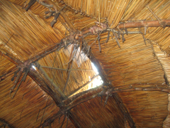
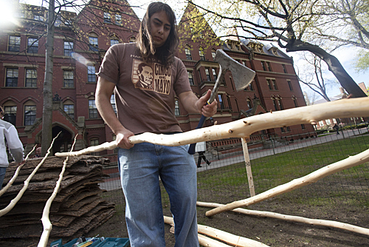
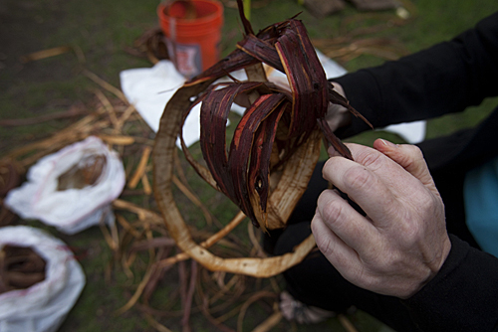
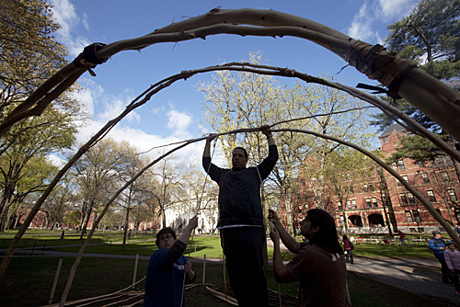
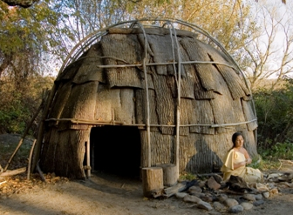
Wetu
Can you put the pictures in the correct order?
Hole in the roof allowed the smoke from the fire to escape
Cattail mats or bark used to cover the homes
Saplings gathered in the spring
Men peeled the bark off the saplings
https://news.harvard.edu/gazette/story/2010/04/building-on-tradition/
https://amybeldingbrown.wordpress.com/tag/wetu/
http://www.plimoth.org/learn/just-kids/homework-help/building-home
Bark split and used to construct the frame
A finished wetu

Slide 3
Wetu - answers
Saplings gathered in the spring
Men peeled the bark off the saplings
Bark split and used to construct the frame
Cattail mats or bark used to cover the homes
Hole in the roof allowed the smoke from the fire to escape
When finished, the homes belonged to the women, as a place to protect the children

