Slide 1
Pilgrim Homes
The Pilgrims arrived in Plymouth, Massachusetts, in the middle of winter, and were not use to such harsh weather. Many were already exhausted from the long journey. Yet, with no English towns nearby, they would need to build their homes before they could settle in for the remaining winter months. They had brought the necessary tools with them, and would get the materials they needed from the surrounding land.
Below are the instructions for constructing a Pilgrim house but they need to be put in the correct order:
The wattle would be covered with daub, a mixture of clay, earth, grass and water
The squared trees would be fitted together to form the frame
Split wood, called clapboards, would be nailed over the frame to create the outside walls
The men cut down trees from the woods
The thatched roofs would be made from grass and reeds, and added in layers to the roof
The inside walls would start with frames of small sticks, called wattle
They men would use axes to trim the trees into square shapes
Draw what you think a Pilgrim house would look like.
Why do you think the Pilgrims built their homes like this? Think about resources, time and man power.
Why do you think practicality and comfort were not as important for the Pilgrims at that time? Think about the Pilgrims’ long term plans and investments.
In what ways do you think the Pilgrims’ houses differ from the homes made by the Wampanoag?Think about the skills, tools and understanding about living off the land each group may have had.
Draw what you think a Wampanoag house would look like and label the differences.

Slide 2
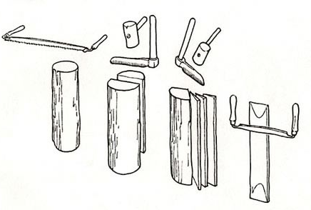
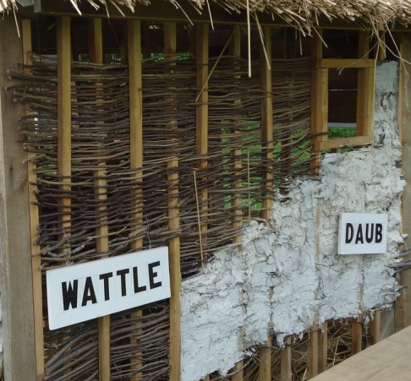
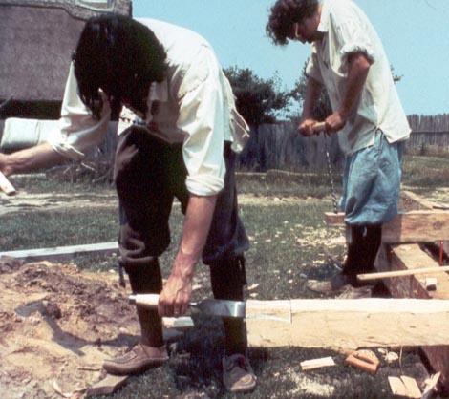
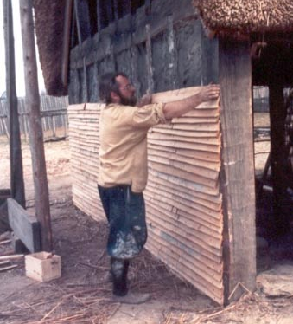
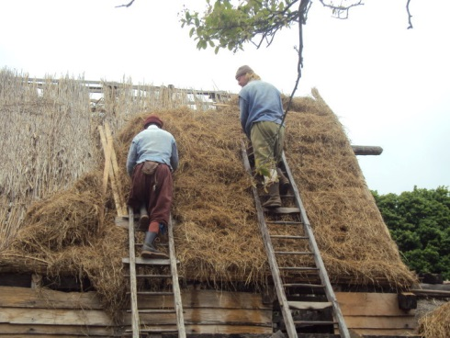
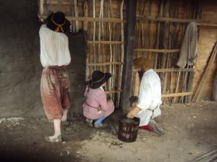
Pilgrim Homes
The men cut down trees from the woods
Can you put the pictures in the correct order?
The inside walls would start with frames of small sticks, called wattle
The squared trees would be fitted together to form the frame
They men would trim the trees into square shapes
Split wood, called clapboards, would be nailed over the frame to create the outside walls
The thatched roofs would be made from grass and reeds, and added in layers to the roof
The wattle would be covered with daub, a mixture of clay, earth, grass and water
http://www.histarch.illinois.edu/plymouth/framing11.html
http://www.plimoth.org/learn/just-kids/homework-help/building-home
http://www.milaminvirginia.com/Links/HOUSES/colonial_virginia_and_maryland_houses.html
http://buildunderstanding.weebly.com/resources.html

Slide 3
Pilgrim Homes - answers
The men cut down trees from the woods
They men would use axes to trim the trees into square shapes
The squared trees would be fitted together to form the frame
Split wood, called clapboards, would be nailed over the frame to create the outside walls
The thatched roofs would be made from grass and reeds, and added in layers to the roof
The inside walls would start with frames of small sticks, called wattle
The wattle would be covered with daub, a mixture of clay, earth, grass and water

